Slide 1
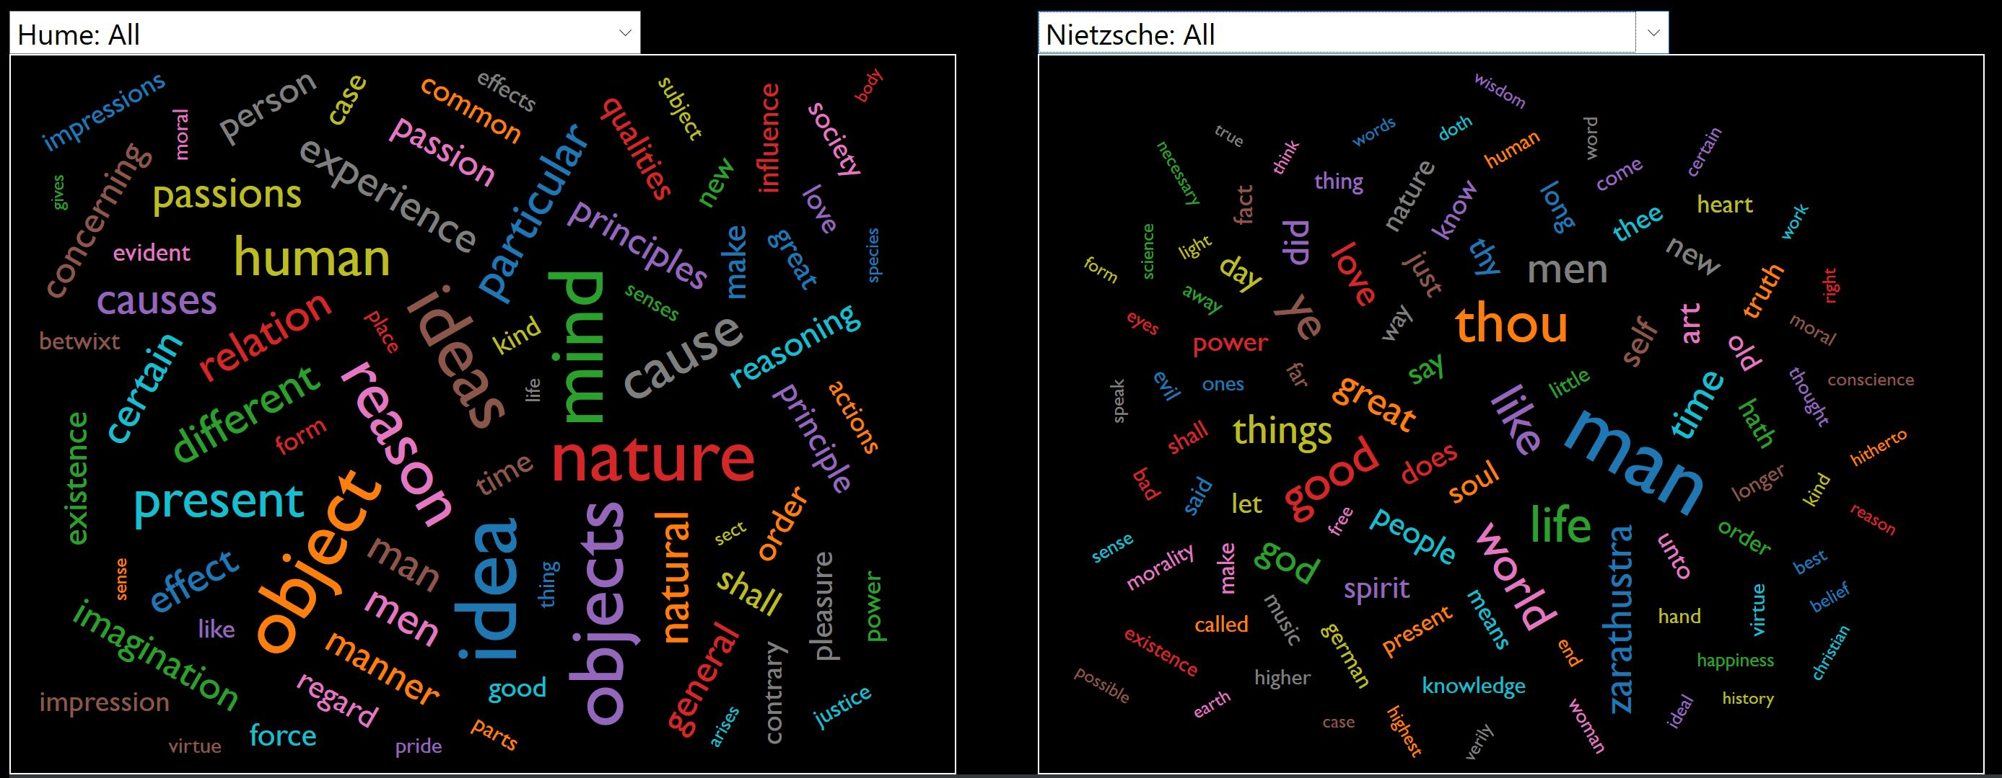
Visualizing concepts in philosophy

Slide 2
Visualizing concepts in philosophy
Overview
Using SKLearn and D3, I created Word Clouds for a set of philosophical texts to compare and contrast the 100 most common words used within each of the those documents

Slide 3
Visualizing concepts in philosophy
Steps (Data Collection and Data cleaning)
Download Texts from Project Guttenberg
Project Guttenberg is an online resource with thousands of texts in the public domain
After downloading each text, I had to clean the text files by removing:
All the Project Guttenberg notes
Copyright statements
Translator and Editor Introductions

Slide 4
Visualizing concepts in philosophy
Steps (Data Collection and Data cleaning)
Selected Philosophers and Texts
David Hume | Immanuel Kant | Friedrich Nietzsche
An Enquiry Concerning Human Understanding | Critique of Judgment | The Anti-Christ
An Enquiry Concerning the Principles of Morals | Critique of Pure Reason | Beyond Good and Evil
Dialogues Concerning Natural Religion | Critique of Practical Reason | Birth of Tragedy
Treatise of Human Nature | Grounding for a Metaphysics of Morals | Ecce Homo
 | Prolegomena for any Future Metaphyics | Geneaology of Morals
 |  | Human, All Too Human
 |  | Joyful Wisdom
 |  | Thus Spoke Zarathustra

Slide 5
Visualizing concepts in philosophy
Steps (Word Frequency analysis)
Once the texts were downloaded and cleaned, I used SKLearn to do a word frequency analysis on each text.
Read each file from the filesystem, and save a text stream of the file into a variable.
Pass that text stream into a function [get_most_common_words(textStream)] to compute the 100 most common words in the text, removing common stop words from the analysis.
The function returns a list of tuples containing the word and its count within the text
Example (Hume’s Enquiry Concerning Human Understanding):
enquiry_text = read_file('texts/hume/enquiryhumanunderstanding.txt')
enquiry_ngrams = get_most_common_words(enquiry_text)
[('nature', 200), ('experience', 166), ('cause', 155)….]
After each text by each philosopher was analyzed, then combine all the texts from that philosopher into a single textstream, and then perform the analysis on the entire corpus of that philosopher
Example (Hume)
hume_text = enquiry_text + humannature_text + naturalreligion_text + humemorals_text
hume_ngrams = get_most_common_words(hume_text)

Slide 6
Visualizing concepts in philosophy
Steps (json)
Once the word frequency objects were created, they had to be converted into a list of dictionaries. This was done using list comprehensions and a custom format_tuple() function that cast each tuple into a dictionary item
Example
enquiry_dictlist = [format_tuple(item) for item in enquiry_ngrams ]
Once all _dictlists were created, create a dictionary of all the dictionaries, and then save that off as a JSON
Example
word_dictionary = { 'Hume: All': hume_dictlist, 'Hume: An Enquiry Concerning Human Understanding' : enquiry_dictlist, 'Hume: An Enquiry Concerning the Principles of Morals':humemorals_dictlist, 'Hume: Dialogues Concerning Natural Religion': naturalreligion_dictlist, 'Hume: Treatise of Human Nature':humannature_dictlist, …. }
The key for each _dictlist then functioned as the search term for the website.

Slide 7
Visualizing concepts in philosophy
Steps (website)
The website and word clouds were built with HTML, Bootstrap, and D3
D3 does not have a standard WordCloud library, but there is an open-sourced additional library that was developed and is maintained separately from the standard D3 codebase (d3.layout.cloud.js).
The main parts needed to build this site were as follows:
Create an HTML page with two separate SVG containers, one for each word cloud.
Read the keys from the JSON into each of the Select Menus
When a menu is changed, filter the JSON to pull out only the selected key’s dictionary, and then pass that object into the wordcloud layout function for that particular menu
The layout function then creates the word cloud, where the font size of each word is based on a scaled transformation of the respective word’s frequency in the text.

Slide 8
Visualizing concepts in philosophy
Steps (d3)
Scale Transformation of Font Size
The Word Cloud library defaults to using the Square Root of the Count Frequency to determine the font size for each of the selected words.
This wouldn’t work here, because in comparing different texts and different authors who use different words, those differences in base frequency won’t properly map to the respective importance of those words relative to others in the word cloud.
Example:
David Hume uses “Nature” 200 times in his ‘Enquiry of Human Understanding’. This is his most important term in that book.
Immanuel Kant uses “Reason” 1100+ times in his ‘Critique of Pure Reason’. That is his most important term
We want font size to be scaled based on importance within a text, so we have to use D3’s scaleLinear to map the domain frequency to a normalized range. This is done within the selectText() function, which reads in the dictionary for the selectedText and then maps the frequency to a standardized font size.

Slide 9
Visualizing concepts in philosophy
Steps (d3)
Scale Transformation of Font Size
function showText(selectedText, menuNum) {
if (selectedText !== '...Select Text...') {
wordValues = data[selectedText]
minVal = d3.min(wordValues, v=>+v.value)
maxVal = d3.max(wordValues, v=>+v.value) let scaleType = d3.scaleLinear()
.domain([minVal,maxVal])
.range([10,50])
wordCloudData.length = 0;
wordValues.forEach(function(word) {
word.text = word.text
word.value = scaleType(word.value)
wordCloudData.push(word)
})
if (menuNum === 'menu1') {
makeCloud1();
} else {
makeCloud2();
}
}

Slide 10
Visualizing concepts in philosophy
Steps (d3 cloud layout)
To create the word clouds, two primary functions are used:
let wordCloudlayout1 = d3.layout.cloud() .size([500, 400]) .words(wordCloudData) .font("Gill Sans MT") .padding(5) .on("end", draw1); wordCloudlayout1.start(); | function draw1(words) { d3.select("#cloud1") .append("g") .attr("transform", "translate(" + wordCloudlayout1.size()[0] / 2 + "," + wordCloudlayout1.size()[1] / 2 + ")") .selectAll("text") .data(words) .enter() .append("text") .text((d) => d.text) .style("font-size", (d) => (d.value) + "px") .style("font-family", (d) => d.font) .style("fill", (d, i) => color(i)) .attr("text-anchor", "middle") .attr("transform", (d) => "translate(" + [d.x, d.y] + ")rotate(" + d.rotate + ")") .exit() .remove() }

Slide 11
Visualizing concepts in philosophy
Steps (Next steps)
This is the just the first revision of this website.
Things to add:
Stemming & Lemmatization to reduce individual words to their roots
‘Idea’ and ‘Ideas’ are possibly the same (although not always!) and could be summed together in the frequency.
Increase ngram size from unigrams to bi/tri-grams to get a better understanding of conceptual compounding
Kant draws a distinction between “Pure Reason” and “Practical Reason”, so that is lost when only using unigrams of “Reason”, “Pure”, and “Practical”.

Slide 12
Visualizing concepts in philosophy
Thanks for watching!
Let me know if you have any questions or comments!

